Slide 1


Decision Tree Classifier
By: Sidhidatri Nayak
CDAC,NOIDA,India

Slide 2
Notice regarding the usage of images:
This document contains images obtained by routine Google
Images searches. Some of these images may perhaps be under
copyright. They are included here for educational and
noncommercial purposes and are considered to be covered by
the doctrine of Fair Use. In any event they are easily available
from Google Images.

Slide 3

Decision Tree Classifier
A decision tree is a flowchart-like tree structure.
An internal node represents feature(or attribute)
the branch represents a decision rule
Each leaf node represents the outcome.
The topmost node in a decision tree is known as the root node.
It learns to partition based on the attribute value.
It partitions the tree in recursively manner call recursive partitioning.
This flowchart-like structure helps you in decision making.
It's visualization like a flowchart diagram which easily mimics the human level thinking.
That is why decision trees are easy to understand and interpret.

Slide 4
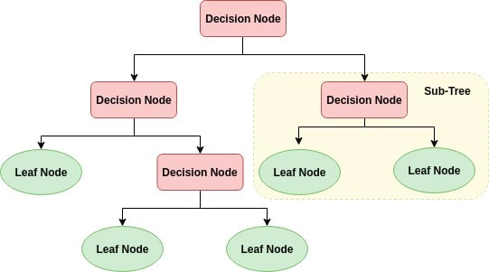
Decision tree

Slide 5
How does the Decision Tree algorithm work?
Select the best attribute using Attribute Selection Measures(ASM) to split the records.
Make that attribute a decision node and breaks the dataset into smaller subsets.
Starts tree building by repeating this process recursively for each child until one of the condition will match:
All the tuples belong to the same attribute value.
There are no more remaining attributes.
There are no more instances.

Slide 6
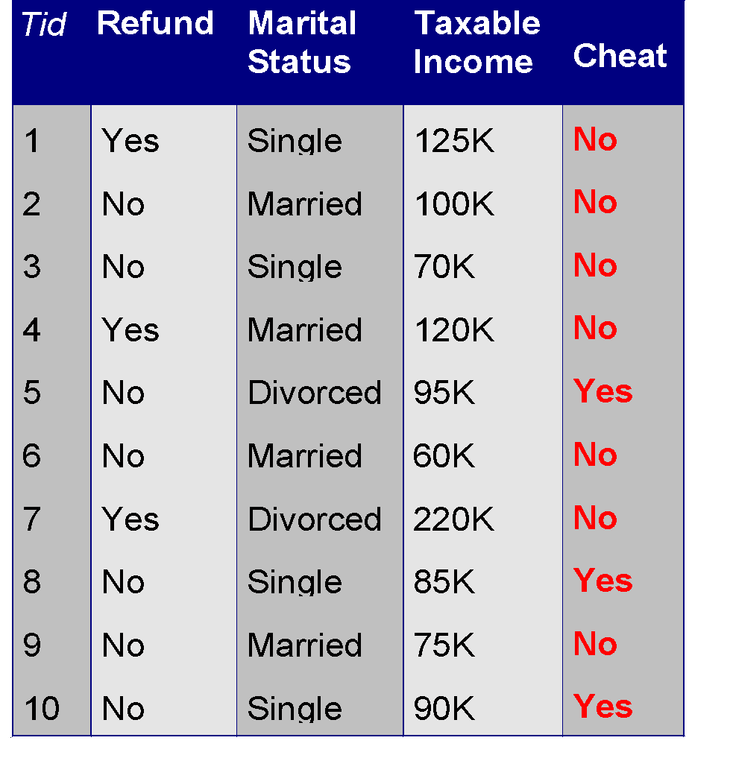
Decision Tree Classifier
Splitting Attributes
categorical
categorical
continuous
class
Refund
NO
MarSt
Single, Divorced
Married
TaxInc
NO
< 80K
> 80K
NO
YES
Training Data
Model: Decision Tree

Slide 7
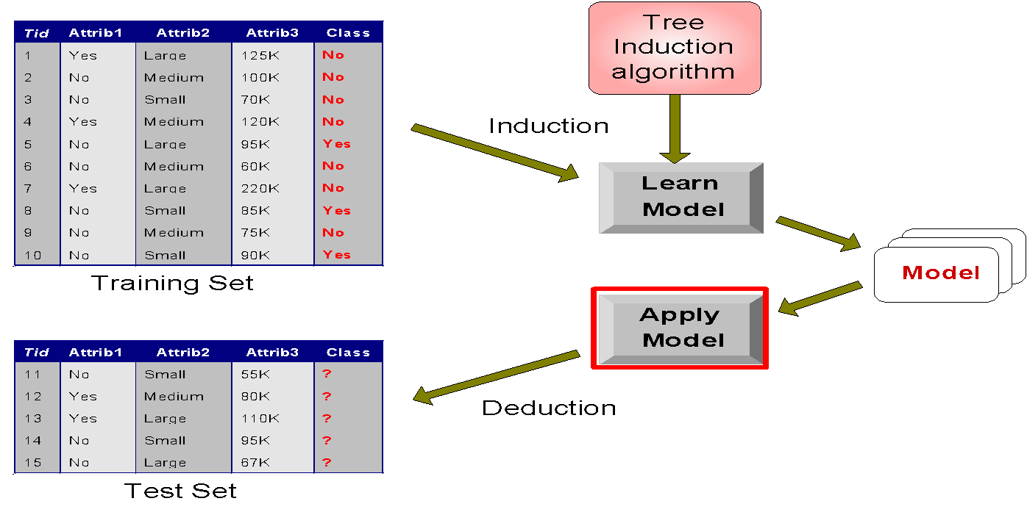
Decision Tree Classifier

Slide 8
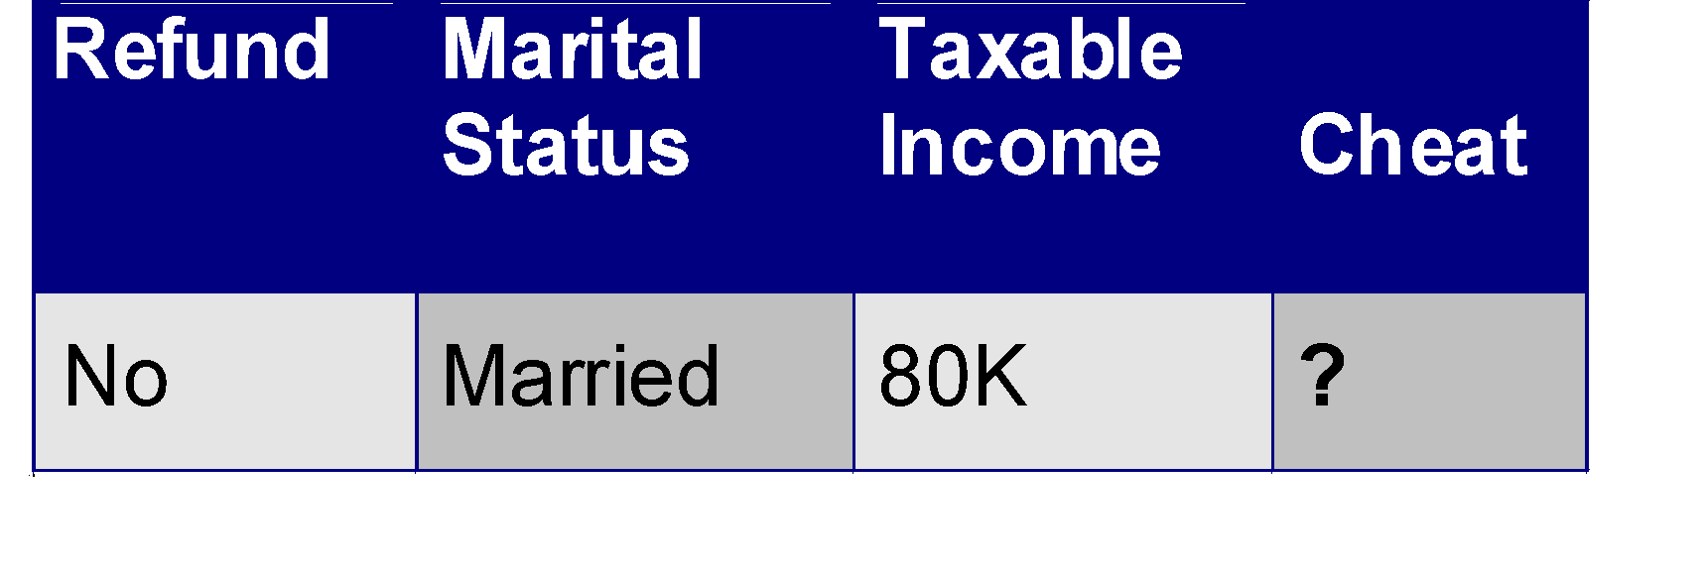
Apply Model to Test Data
Start from the root of tree.
Test Data
Refund
Yes
No
NO
MarSt
Single, Divorced
Married
TaxInc
NO
< 80K
> 80K
NO
YES

Slide 9
Apply Model to Test Data
Test Data
Refund
Yes
No
NO
MarSt
Single, Divorced
Married
TaxInc
NO
< 80K
> 80K
NO
YES

Slide 10
Apply Model to Test Data
Test Data
Refund
Yes
No
NO
MarSt
Single, Divorced
Married
TaxInc
NO
< 80K
> 80K
NO
YES

Slide 11
Apply Model to Test Data
Test Data
Refund
Yes
No
NO
MarSt
Single, Divorced
Married
TaxInc
NO
Assign Cheat to “No”
< 80K
> 80K
NO
YES

Slide 12
Decision Tree Classifier
Greedy strategy: Split the records based on an attribute test that optimizes certain criterion.
Issues
Determine how to split the records
How to specify the attribute test condition?
How to determine the best split?
Determine when to stop splitting
How to Specify Test Condition?
Depends on attribute types
Nominal
Ordinal
Continuous
Depends on number of ways to split
2-way split
Multi-way split

Slide 13
Decision Tree Classifier
Splitting based on Nominal Attributes
Multi-way split: Use as many partitions as distinct values.
Binary split: Divides values into two subsets.
Splitting based on Ordinal Attributes
Multi-way split: Use as many partitions as distinct values.
Binary split: Divides values into two subsets
Family
CarType
Luxury
Sports
Size
Small
Large
{Family, Luxury}
CarType
Medium
{Sports, Luxury}
CarType
OR
{Sports}
{Family}
{Small, Medium}
Size
OR
{Medium, Large}
Size
{Large}
{Small}

Slide 14
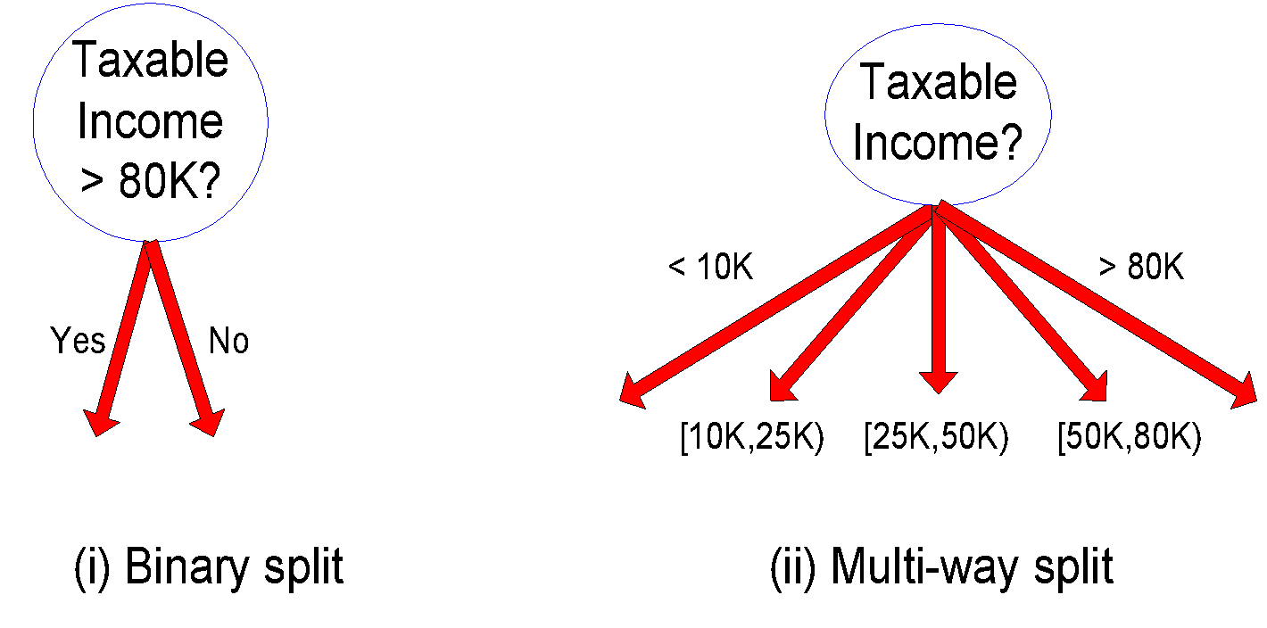
Decision Tree Classifier
Splitting based on Continuous Attributes
Discretization to form an ordinal categorical attribute
ranges can be found by equal interval bucketing, or clustering.
Binary Decision: (A < v) or (A ≥ v)
consider all possible splits and finds the best cut
can be more compute intensive

Slide 15
Decision Tree Induction Techniques
Different algorithms have been proposed to take a good control over
Choosing the best attribute to be splitted, and
Splitting criteria
Several algorithms have been proposed for the above tasks. In this lecture, we shall limit our discussions into three important of them
ID3
CART

Slide 16
Algorithm ID3
In ID3, entropy is used to measure how informative a node is.
ID3 algorithm defines a measurement of a splitting called Information Gain to determine the goodness of a split.
The attribute with the largest value of information gain is chosen as the splitting attribute and
it partitions into a number of smaller training sets based on the distinct values of attribute under split.

Slide 17
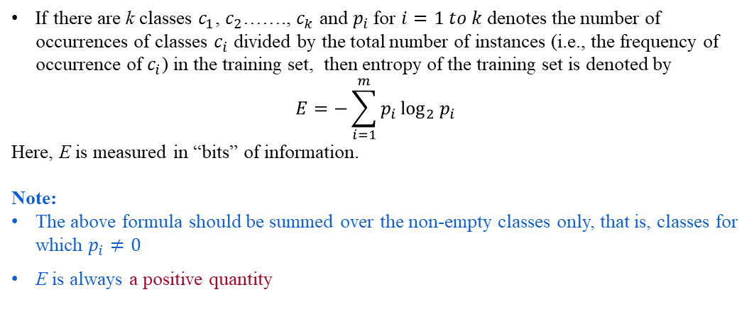
Entropy of a Training Set

Slide 18
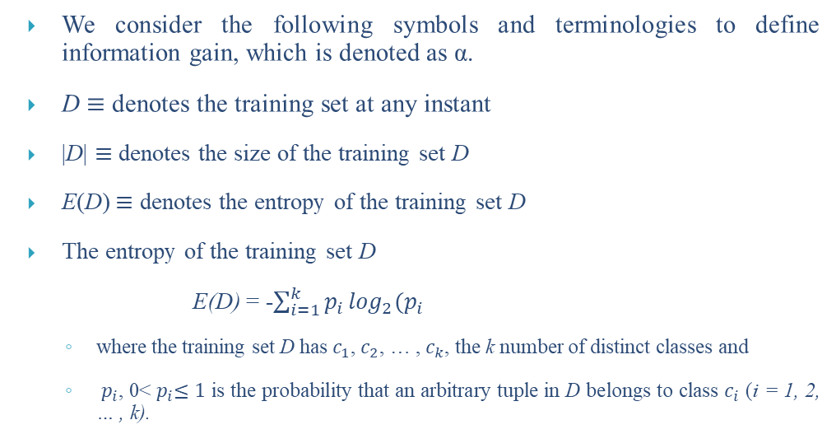
Defining Information Gain

Slide 19
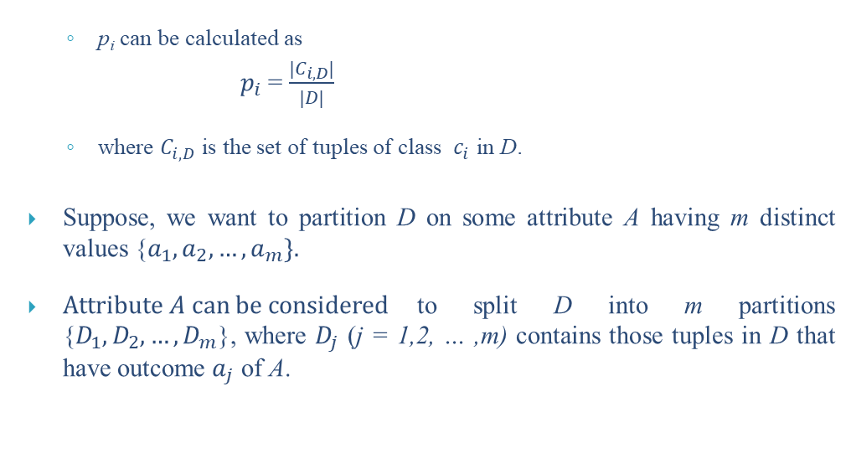
Defining Information Gain

Slide 20
Entropy of a Training Set
OPTH dataset
Consider the OTPH data shown in the following table with total 24 instances in it.
Age | Eye sight | Astigmatic | Use Type | Class
1 1 1 1 1 1 | 1 1 1 1 2 2 | 1 1 2 2 1 1 | 1 2 1 2 1 2 | 3 2 3 1 3 2
1 1 2 2 2 2 | 2 2 1 1 1 1 | 2 2 1 1 2 2 | 1 2 1 2 1 2 | 3 1 3 2 3 1
2 2 2 2 3 3 | 2 2 2 2 1 1 | 1 1 2 2 1 1 | 1 2 1 2 1 2 | 3 2 3 3 3 3
3 3 3 3 3 3 | 1 1 2 2 2 2 | 2 2 1 1 2 2 | 1 2 1 2 1 2 | 3 1 3 2 3 3
A coded forms for all values of attributes are used to avoid the cluttering in the table.

Slide 21
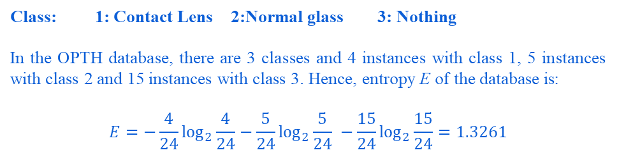
Entropy of a training set
Specification of the attributes are as follows.
Age | Eye Sight | Astigmatic | Use Type
1: Young | 1: Myopia | 1: No | 1: Frequent
2: Middle-aged | 2: Hypermetropia | 2: Yes | 2: Less
3: Old

Slide 22
Note:
The entropy of a training set implies the number of yes/no questions, on the average, needed to determine an unknown test to be classified.
It is very crucial to decide the series of questions about the value of a set of attribute, which collectively determine the classification. Sometimes it may take one question, sometimes many more.
Decision tree induction helps us to ask such a series of questions. In other words, we can utilize entropy concept to build a better decision tree.
How entropy can be used to build a decision tree is our next topic of discussion.

Slide 23
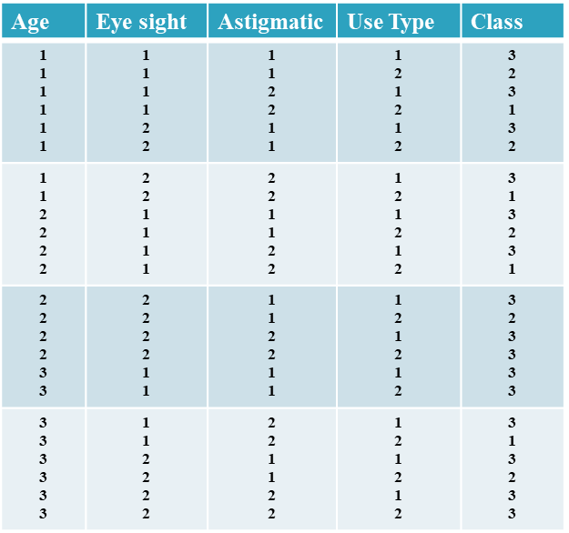
Calculation of α using Frequency Table
OTPH Dataset
With reference to OPTH dataset, and for the attribute Age, the frequency table would look like
 | Age=1 | Age=2 | Age=3 | Row Sum
Class 1 | 2 | 1 | 1 | 4
Class 2 | 2 | 2 | 1 | 5
Class 3 | 4 | 5 | 6 | 15
Column Sum | 8 | 8 | 8 | 24
N=24

Slide 24
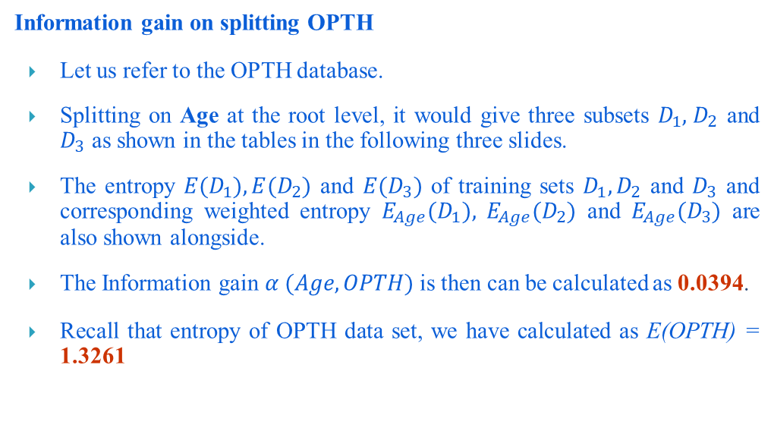
Information Gain Calculation

Slide 25
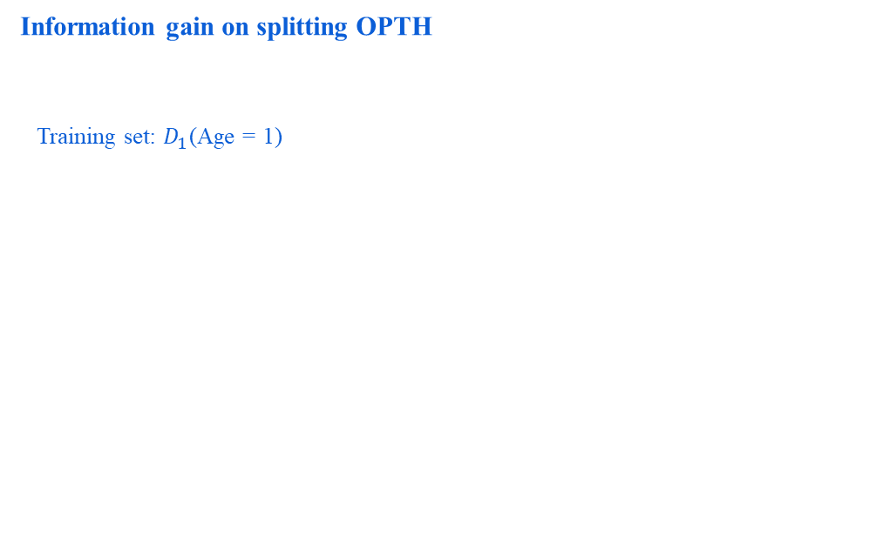
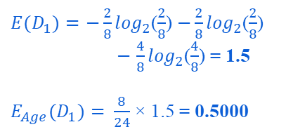
Information Gain Calculation
Age | Eye-sight | Astigmatism | Use type | Class
1 | 1 | 1 | 1 | 3
1 | 1 | 1 | 2 | 2
1 | 1 | 2 | 1 | 3
1 | 1 | 2 | 2 | 1
1 | 2 | 1 | 1 | 3
1 | 2 | 1 | 2 | 2
1 | 2 | 2 | 1 | 3
1 | 2 | 2 | 2 | 1

Slide 26
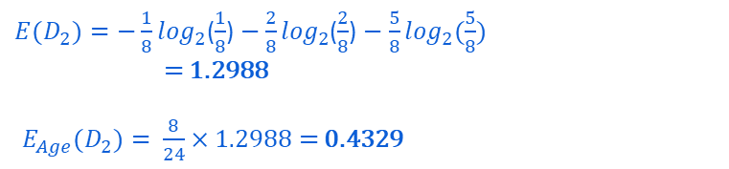
Calculating Information Gain
Age | Eye-sight | Astigmatism | Use type | Class
2 | 1 | 1 | 1 | 3
2 | 1 | 1 | 2 | 2
2 | 1 | 2 | 1 | 3
2 | 1 | 2 | 2 | 1
2 | 2 | 1 | 1 | 3
2 | 2 | 1 | 2 | 2
2 | 2 | 2 | 1 | 3
2 | 2 | 2 | 2 | 3

Slide 27

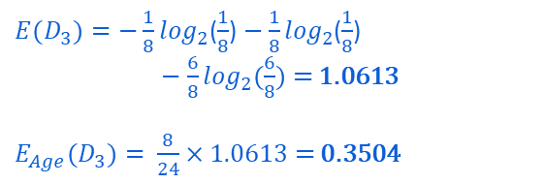
Calculating Information Gain
Age | Eye-sight | Astigmatism | Use type | Class
3 | 1 | 1 | 1 | 3
3 | 1 | 1 | 2 | 3
3 | 1 | 2 | 1 | 3
3 | 1 | 2 | 2 | 1
3 | 2 | 1 | 1 | 3
3 | 2 | 1 | 2 | 2
3 | 2 | 2 | 1 | 3
3 | 2 | 2 | 2 | 3

Slide 28
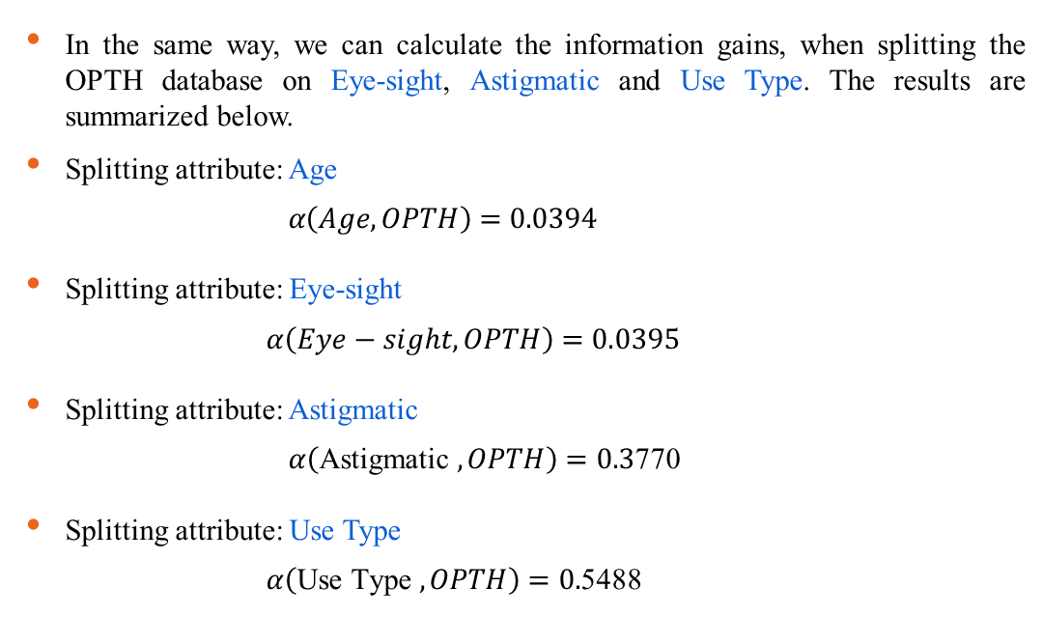
Information Gains for Different Attributes

Slide 29
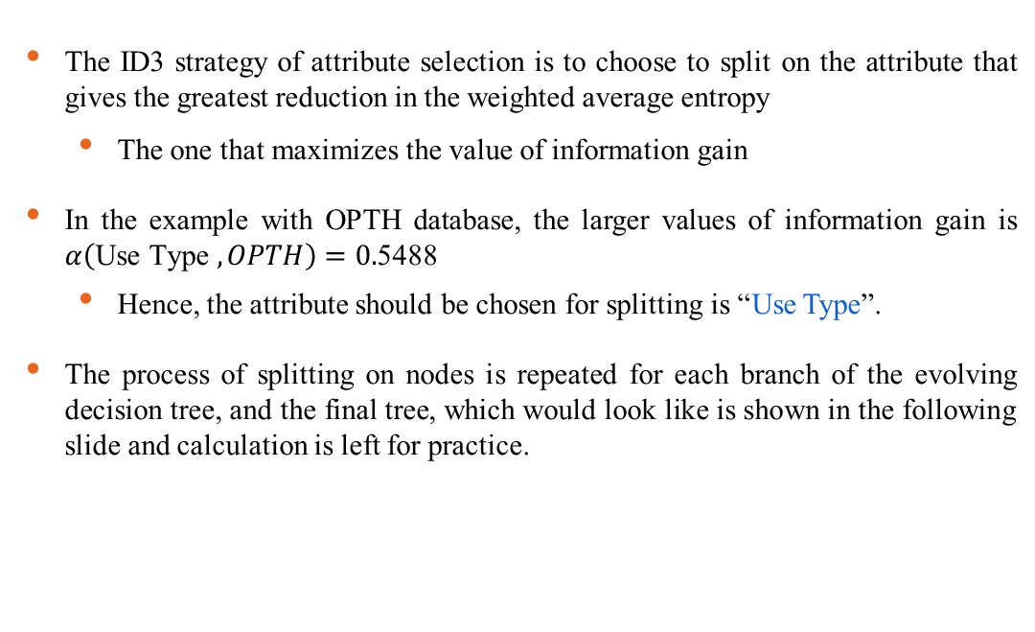
Decision Tree Induction : ID3 Way

Slide 30















Decision Tree Induction : ID3 Way
✔
Age
Eye-sight
Use Type
Astigmatic
Age | Eye | Ast | Use | Class
1 | 1 | 1 | 1 | 3
1 | 1 | 2 | 1 | 3
1 | 2 | 1 | 1 | 3
1 | 2 | 2 | 1 | 3
2 | 1 | 1 | 1 | 3
2 | 2 | 1 | 1 | 3
2 | 2 | 2 | 1 | 3
3 | 1 | 1 | 1 | 3
3 | 1 | 2 | 1 | 3
3 | 2 | 1 | 1 | 3
3 | 2 | 2 | 1 | 3
Age | Eye | Ast | Use | Class
1 | 1 | 1 | 2 | 2
1 | 1 | 2 | 2 | 1
1 | 2 | 1 | 2 | 2
1 | 2 | 2 | 2 | 1
2 | 1 | 1 | 2 | 2
2 | 1 | 2 | 2 | 1
2 | 2 | 1 | 2 | 2
3 | 1 | 1 | 2 | 3
3 | 1 | 2 | 2 | 3
3 | 2 | 1 | 2 | 2
3 | 2 | 2 | 2 | 3
Age
Eye-sight
Astigmatic

Slide 31
Decision Tree Classifier
Stopping Criteria for Decision Tree Algorithm
Stop expanding a node when all the records belong to the same class.
Stop expanding a node when all the records have similar attribute values.
Early termination.

Slide 32
Pros
Decision trees are easy to interpret and visualize.
It can easily capture Non-linear patterns.
It requires fewer data preprocessing from the user, for example, there is no need to normalize columns.
It can be used for feature engineering such as predicting missing values, suitable for variable selection.
The decision tree has no assumptions about distribution because of the non-parametric nature of the algorithm.

Slide 33
Cons
Sensitive to noisy data. It can overfit noisy data.
The small variation(or variance) in data can result in the different decision tree.
This can be reduced by bagging and boosting algorithms.
Decision trees are biased with imbalance dataset, so it is recommended that balance out the dataset before creating the decision tree.

Slide 34
Performance Evaluation Metrics
Classification models must be evaluated to determine their degree of effectiveness for performing a specific task. While good classification models are useful for prediction purposes, poor classification models lead to unreliable outcomes, and thus, are not useful for the user.
Performance evaluation metrics are based on the total number of the following variables:
True Positives: outcome correctly predicted as positive class
True Negatives: outcome correctly predicted as negative class
False Positives: outcome incorrectly predicted as positive class
False Negatives: outcome incorrectly predicted as negative class

Slide 35
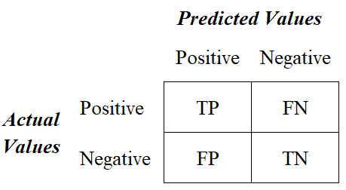
Confusion Matrix

Slide 36
performance metrics
There are four main performance metrics used to evaluate the effectiveness of classification models:
Accuracy: test’s ability to correctly predict both classes
Precision: test’s ability to correctly detect positive classes from all predicted positive classes
Recall (Sensitivity): test’s ability to correctly detect positive classes from all actual positive classes
F1 Score: harmonic mean of precision and recall

Slide 37
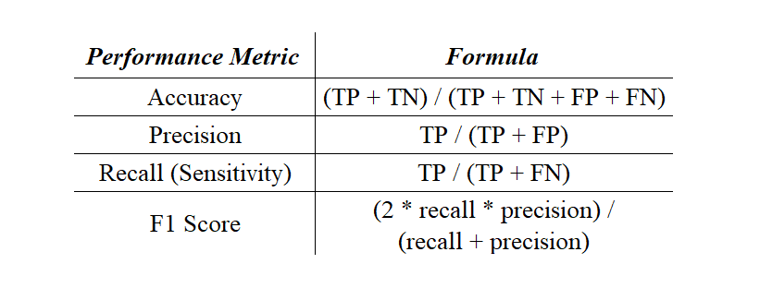

Slide 38
classification report
A classification report is a performance evaluation metric in machine learning.
It is used to show the precision, recall, F1 Score, and support of your trained classification model.
It provides a better understanding of the overall performance of our trained model.

Slide 39
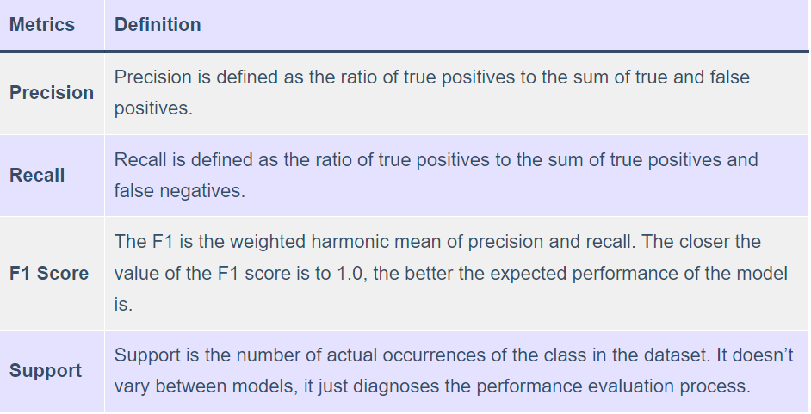

Slide 40
Thank You

